Slide 2
Leveraging SharePoint as a development platform for the modern intranet
Vesa Juvonen
Senior Program Manager
Microsoft
BRK2409

Slide 3


SharePoint in the Enterprise
Microsoft Graph and SharePoint Framework
New cool stuff in SharePoint Framework
SharePoint and Teams enterprise development model
Building portal experiences in SharePoint

Slide 4
Connect the workplace
with intelligent content management and intranets
135M
300k
85%
1M+
Office 365 monthly active users
organizations use SharePoint & OneDrive
Fortune 500 use SharePoint & OneDrive
SharePoint developers
Share and work together
Inform and engage people
Harness collective knowledge
Transform business processes
Protect & manage | Extend & develop

Slide 5
Out of the box

Slide 6
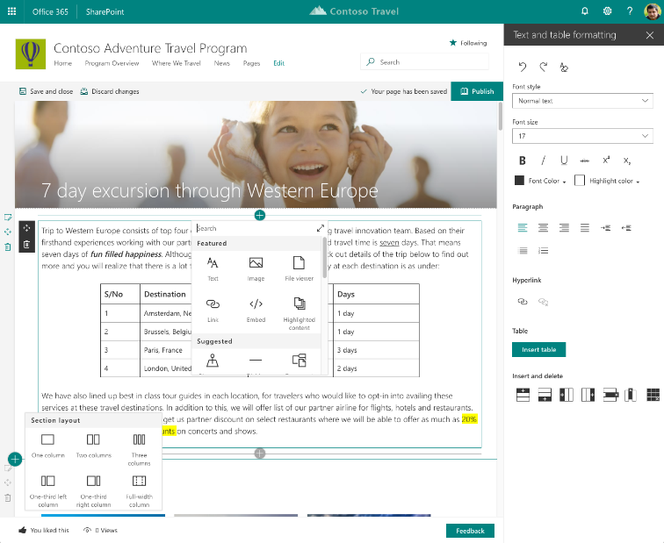
Easily create powerful, beautiful looking pages
Authoring
WYSIWYG authoring
Multi-column sections
Drag/ drop editing
RTE & Paste support
OOB web parts
Page Templates

Slide 7
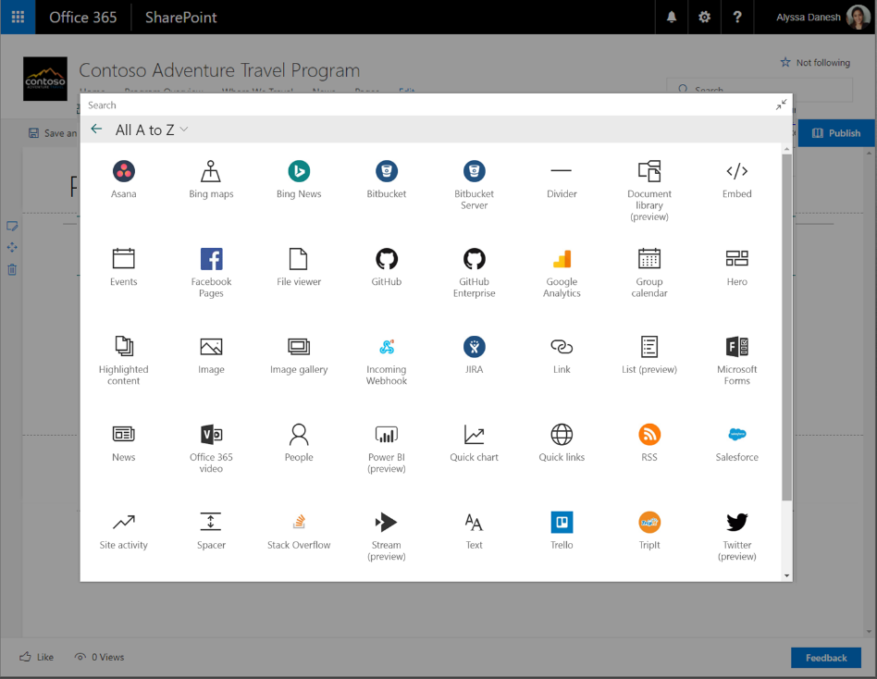
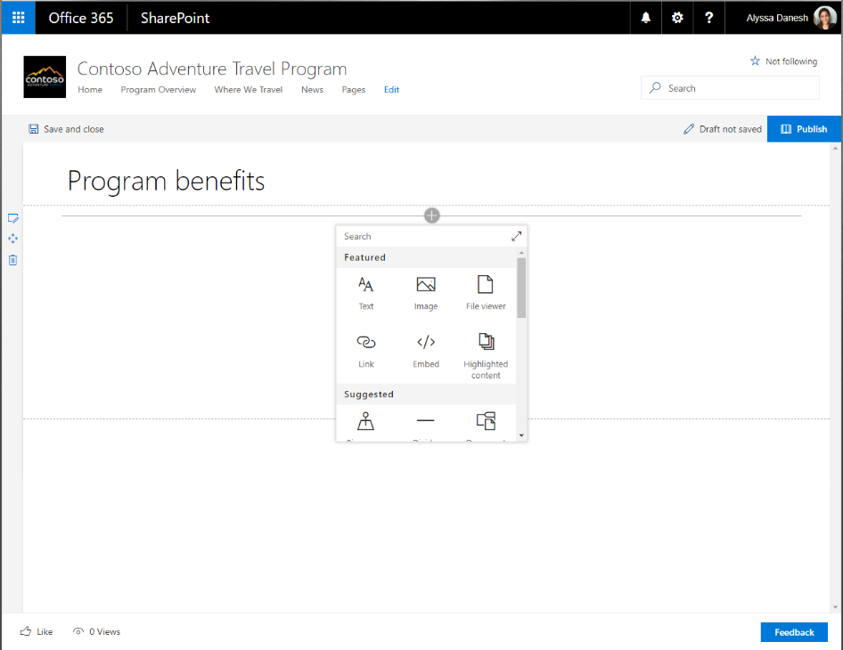
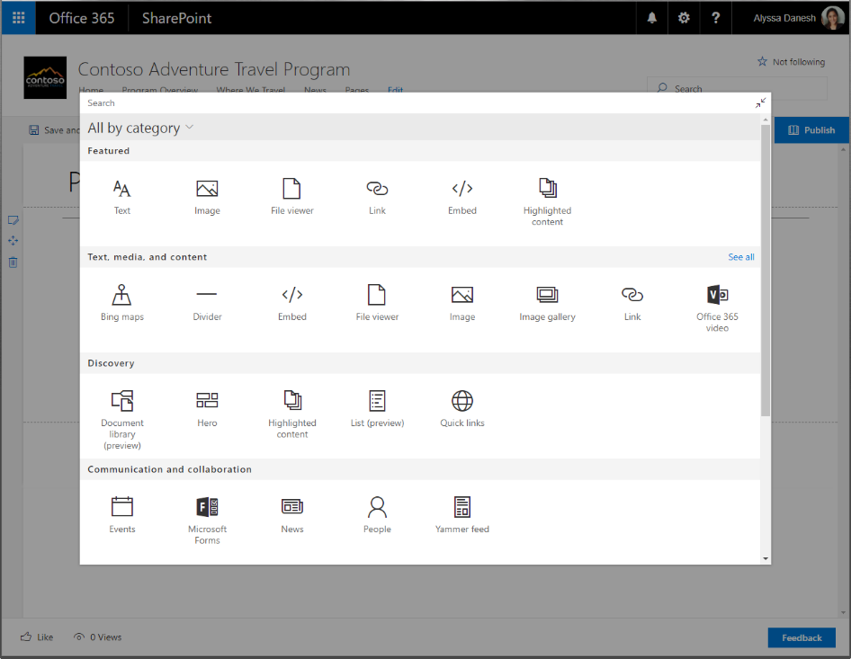
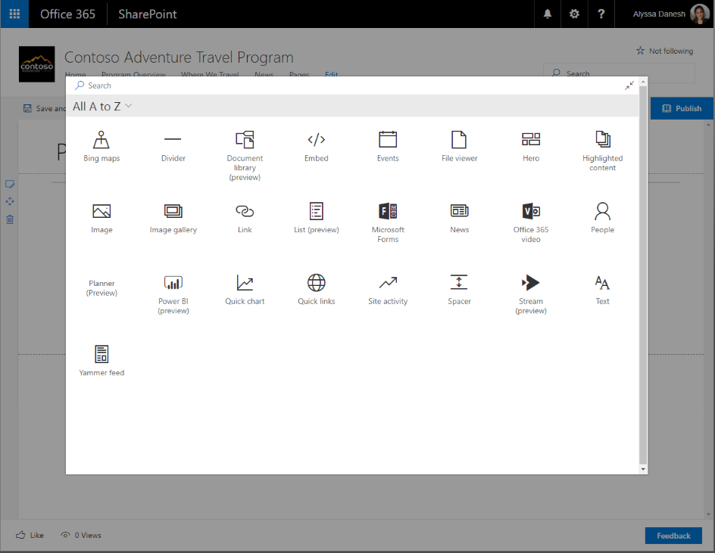
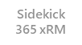
Web Parts and Toolbox
Large Tool Box
Search
Sort by Group or Alpha
Includes Connectors
Includes SharePoint Add-ins

Slide 8
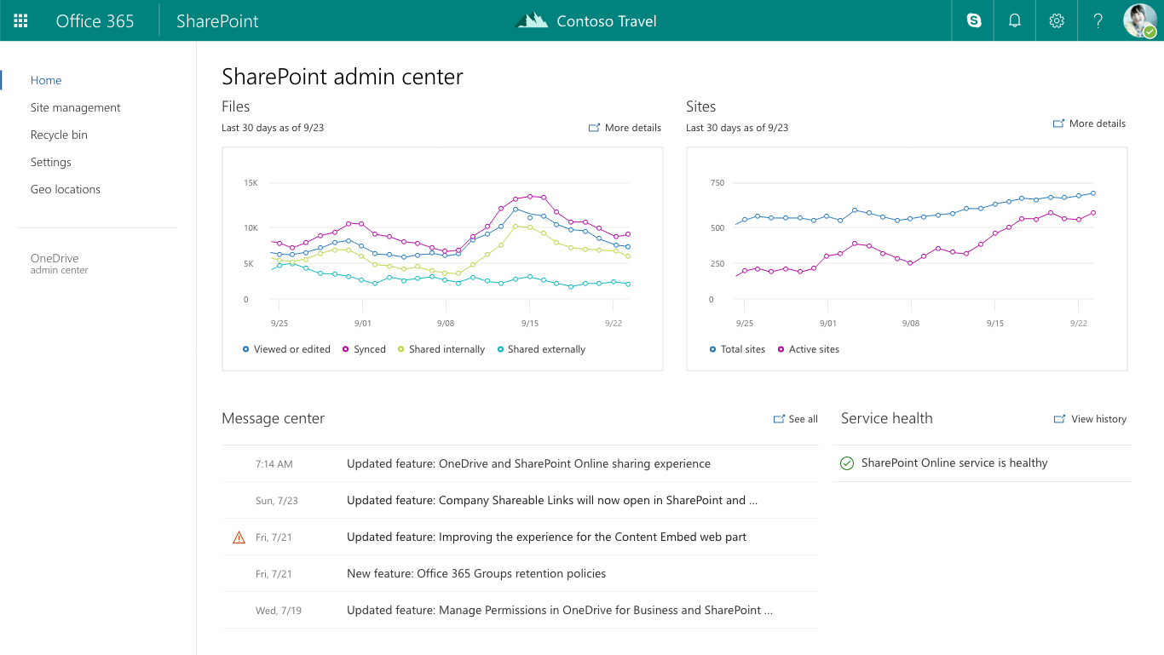
Admin Center
Great new experience for managing modern site types. (Groups, Comm. Sites)
Updated look and feel to match the rest of the SharePoint experience
Build on Modern Tech SPFx + Fabric React

Slide 9
DEMO
Quick look on modern SharePoint

Slide 10
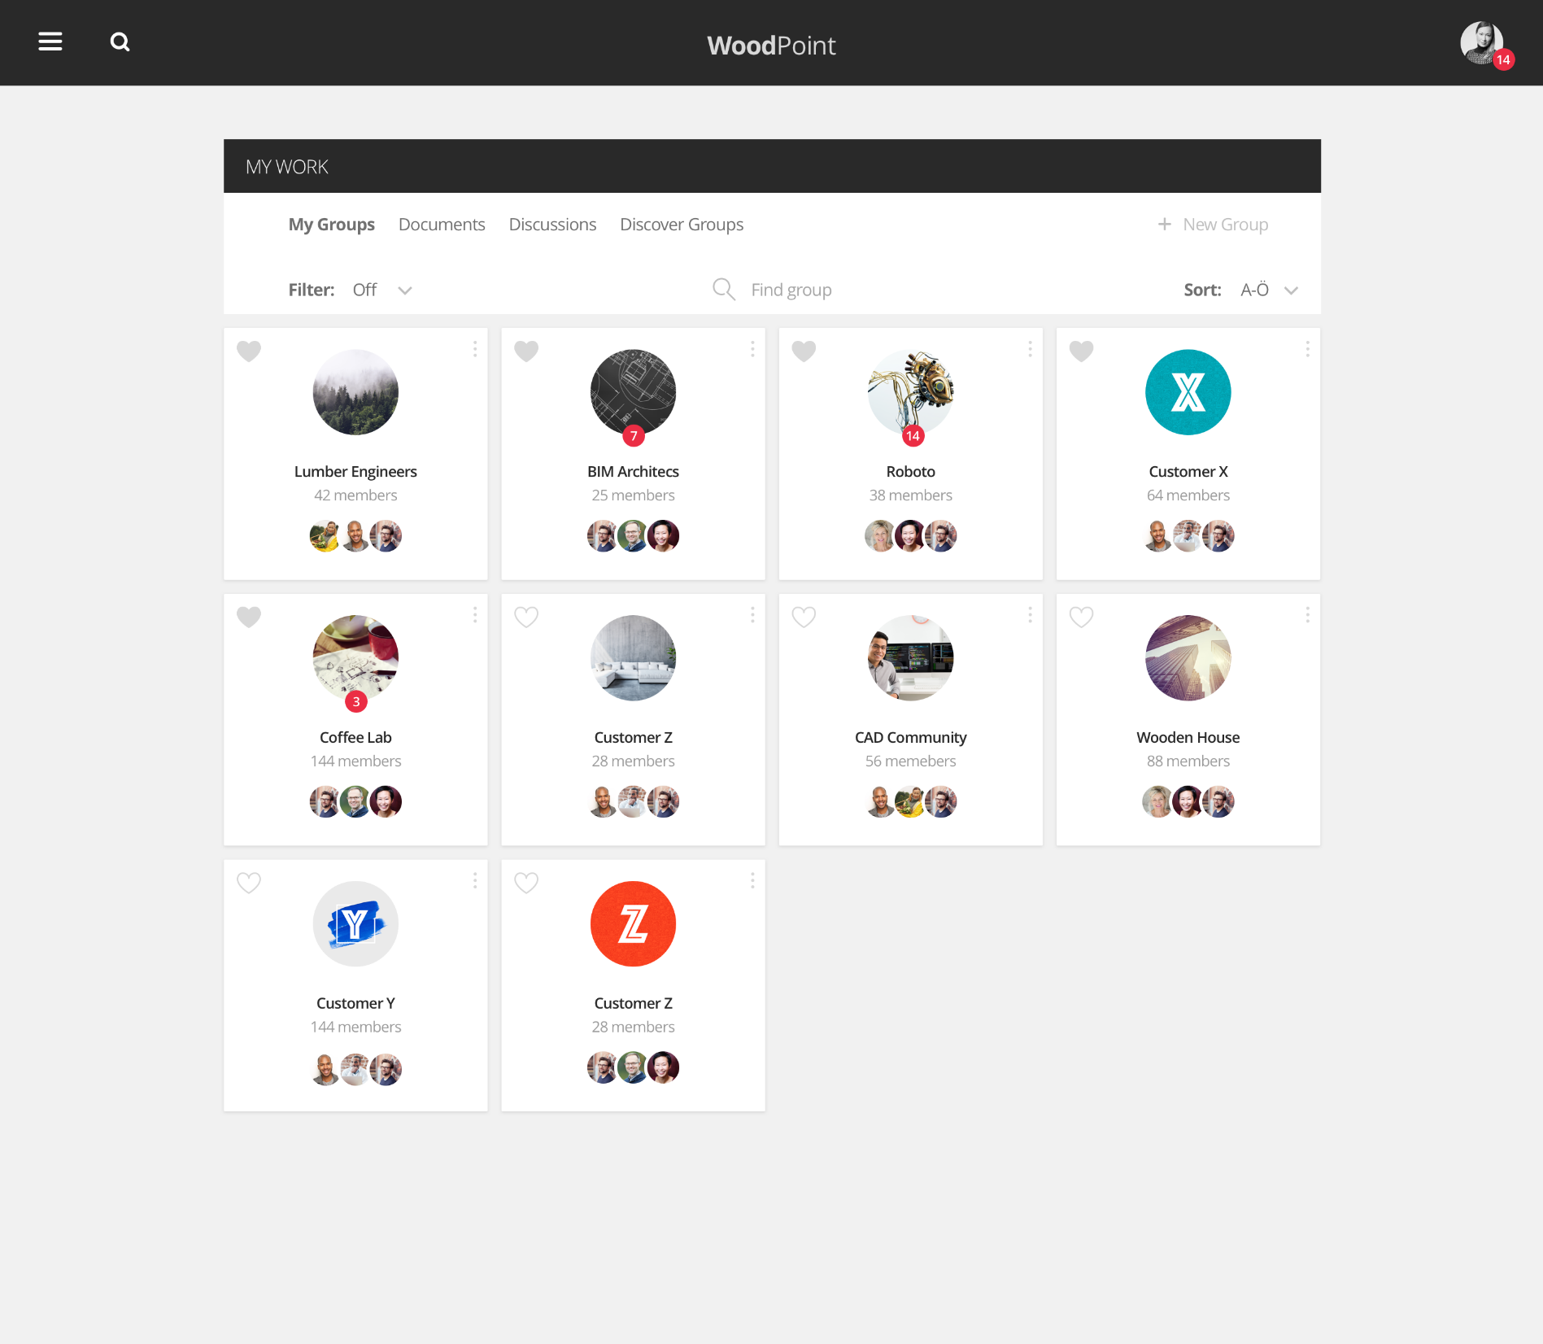

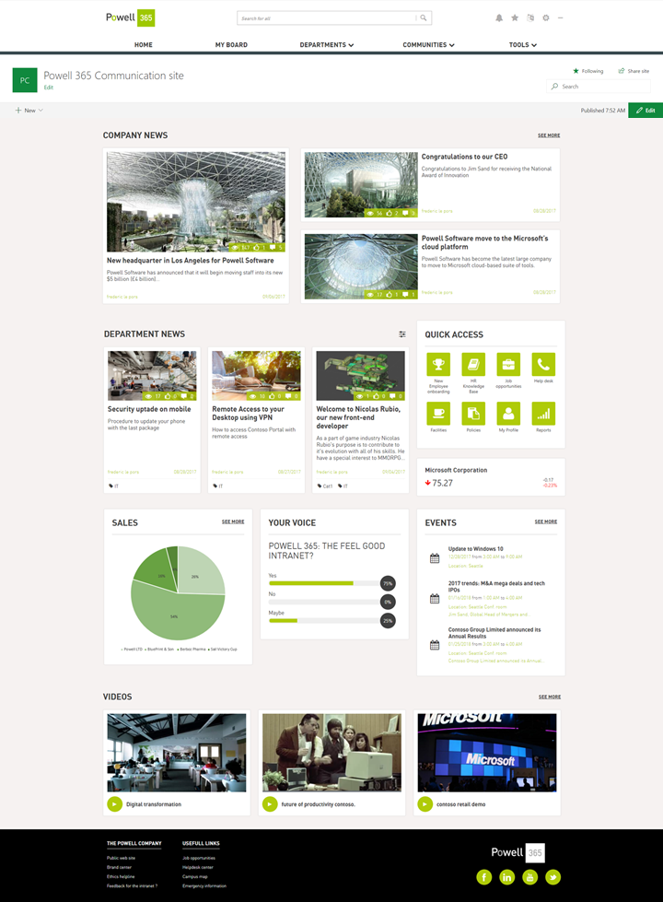

Momentum – Partners building with SharePoint
Valo Intranet Teamwork 2.0
Powell Communication & Team Sites
www.valointranet.com
www.powell-365.com
Notes:
TODO: add Adobe,
Other ODSP partners

Slide 11
Office 365 Platform
Site Experiences
Processes and Workflows
Integrated Tools
Business Applications
Tailored Experiences
SharePoint & OneDrive
gg
User experience

SharePoint Framework (SPFx) PowerApps
gg
Application Logic
Data and APIs
Flow Webhooks
Microsoft Graph
REST (CSOM)
Notes:
Slide will be an animated slide that starts with Experiences. SPFx Momentum. Look to engage with 3M

Slide 12
SharePoint as enterprise development platform

Slide 13
SharePoint Framework and Microsoft Graph
In Preview
Call securely any Graph APIs from the SharePoint Framework solutions
Centralized control for the allowed APIs
Similar support also for 3rd party APIs secured with Azure Active Directory

Slide 14
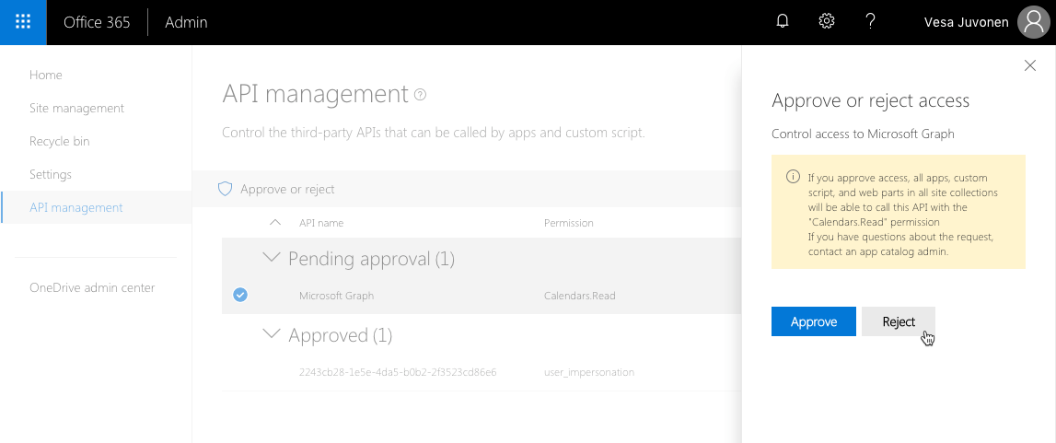
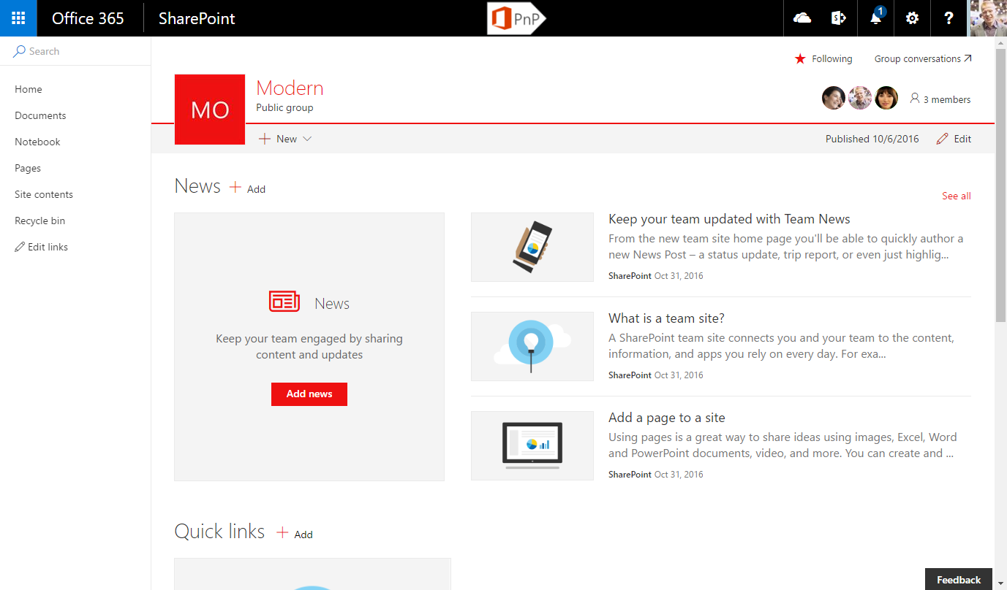
Graph and 3rd party API access
In Preview
Configured access tokens automatically included in the call with needed permissions
Custom
SharePoint Online
3
WebAPI
Client-side web part
Azure Active Directory
2
"SharePoint Online Client“
Permissions - xyz
Tenant administrator configures what scopes are available for the MSGraphClient and AadHttpClient by configuring permissions to specific pre-provisioned application in the Azure Active Directory.
1
Request access tokens from the Azure AD side for the used application

Slide 15
DEMO
SharePoint Framework and Microsoft Graph

Slide 16
SharePoint Framework v1.5
Available soon!
Announcement
Separation of preview and production ready code
New preview capabilities to own release
Support for yarn and pnpm package managers
General improvements and bug fixes

Slide 17
Global deployment of SPFx Extensions
In preview soon
Announcement
Enable SharePoint Framework extensions globally in your tenant
Filter extension enablement based on site and list type
Centralized control for the tenant administrators

Slide 18
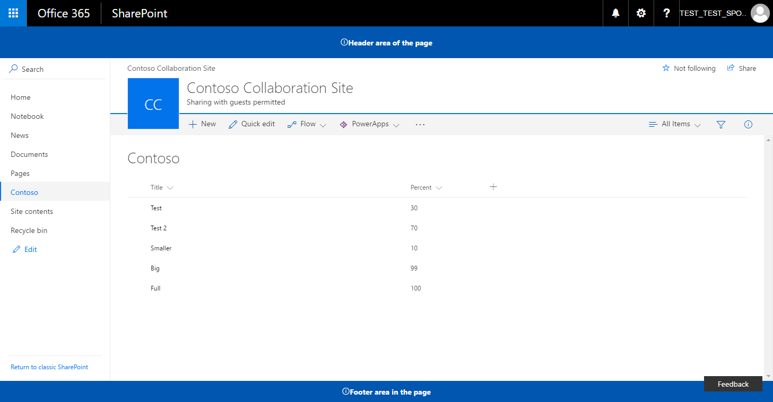
Global deployment of SPFx Extensions - Logical architecture
Preview soon!
Tenant app catalog
Site collection(s)
<<add>>
App catalog
Content site collections
Extension
js
TenantWideExtensions
SPFx solution
Extension
Administrator controls which SharePoint Framework solutions are enabled in the tenant level with different filtering options. This can be done manually or configurations can be included in the SPFx solution packages.
When end users are accessing SharePoint sites, possible tenant wide deployed extensions are rendered based on the configuration in the centralized list in the app catalog site.

Slide 19
DEMO
Global extensions – How to enable easily your extensions to be available across site collections

Slide 20
SharePoint Framework Dynamic Data
Preview soon!
Announcement
Share data easily between components in the page
Can be used by web parts and extensions
Also page or list context available
Initially only code based support, but UI level association coming later
Think as classic web part to web part connections, but including extensions

Slide 21
SharePoint Framework Dynamic Data
Preview soon!
Extension
js
Client-side web part
Client-side web part
Client side web part or Extension can register for the events raised by other components in the page or to information from the context of the site.
SharePoint Framework components exposes to the SharePoint Framework properties which changes are then transmitted for any registered counterparties. Eventually there will be UIs to create connections, but initially this can be achieved from the code.
js
js
2
<<register>>
<<notify>>
<<notify>>
1
SharePoint Framework

Slide 22
DEMO
Dynamic data in SharePoint Framework – Sharing data across components

Slide 23
SharePoint and Teams – Building enterprise solutions which work in both platforms

Slide 24
SharePoint Framework solutions as MS Teams tabs
Coming soon!
Announcement
Write once, surface in SharePoint and also as a tab in the Microsoft Teams
Easy and automatic hosting in the SharePoint
All SharePoint Framework tooling benefits

Slide 25
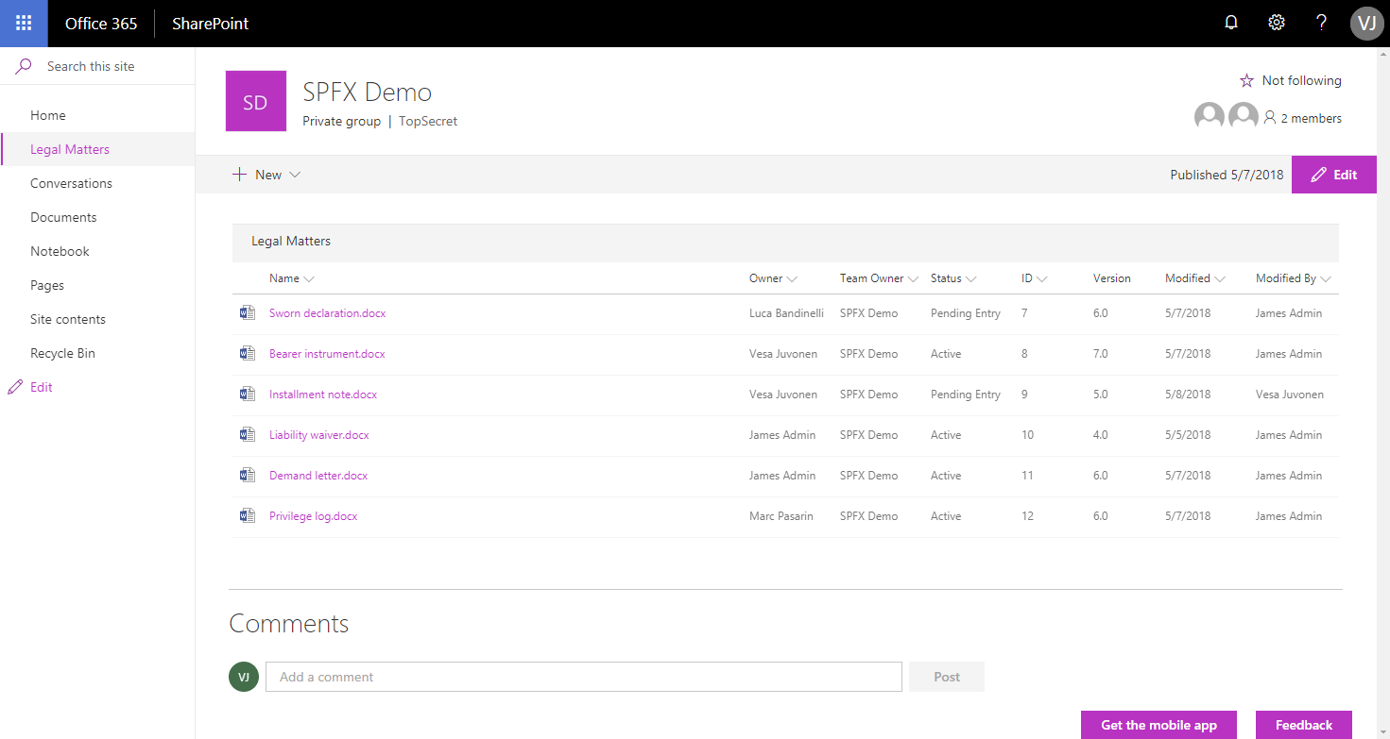
SharePoint Framework Enterprise Solutions in SP
Coming soon!

Slide 26
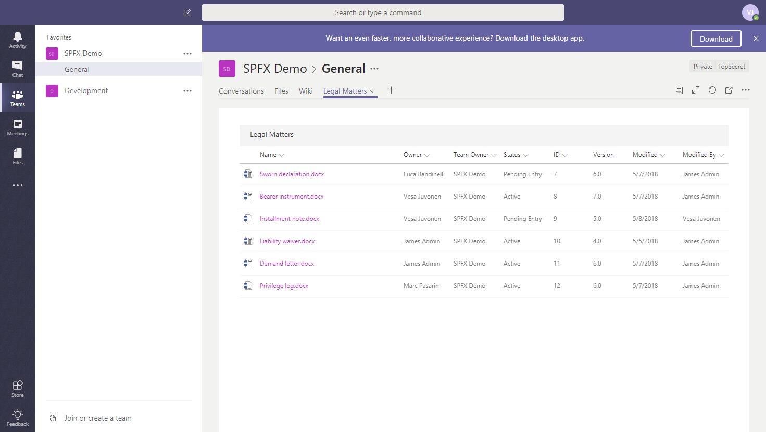
SharePoint Framework Enterprise Solutions in Teams
Coming soon!

Slide 27
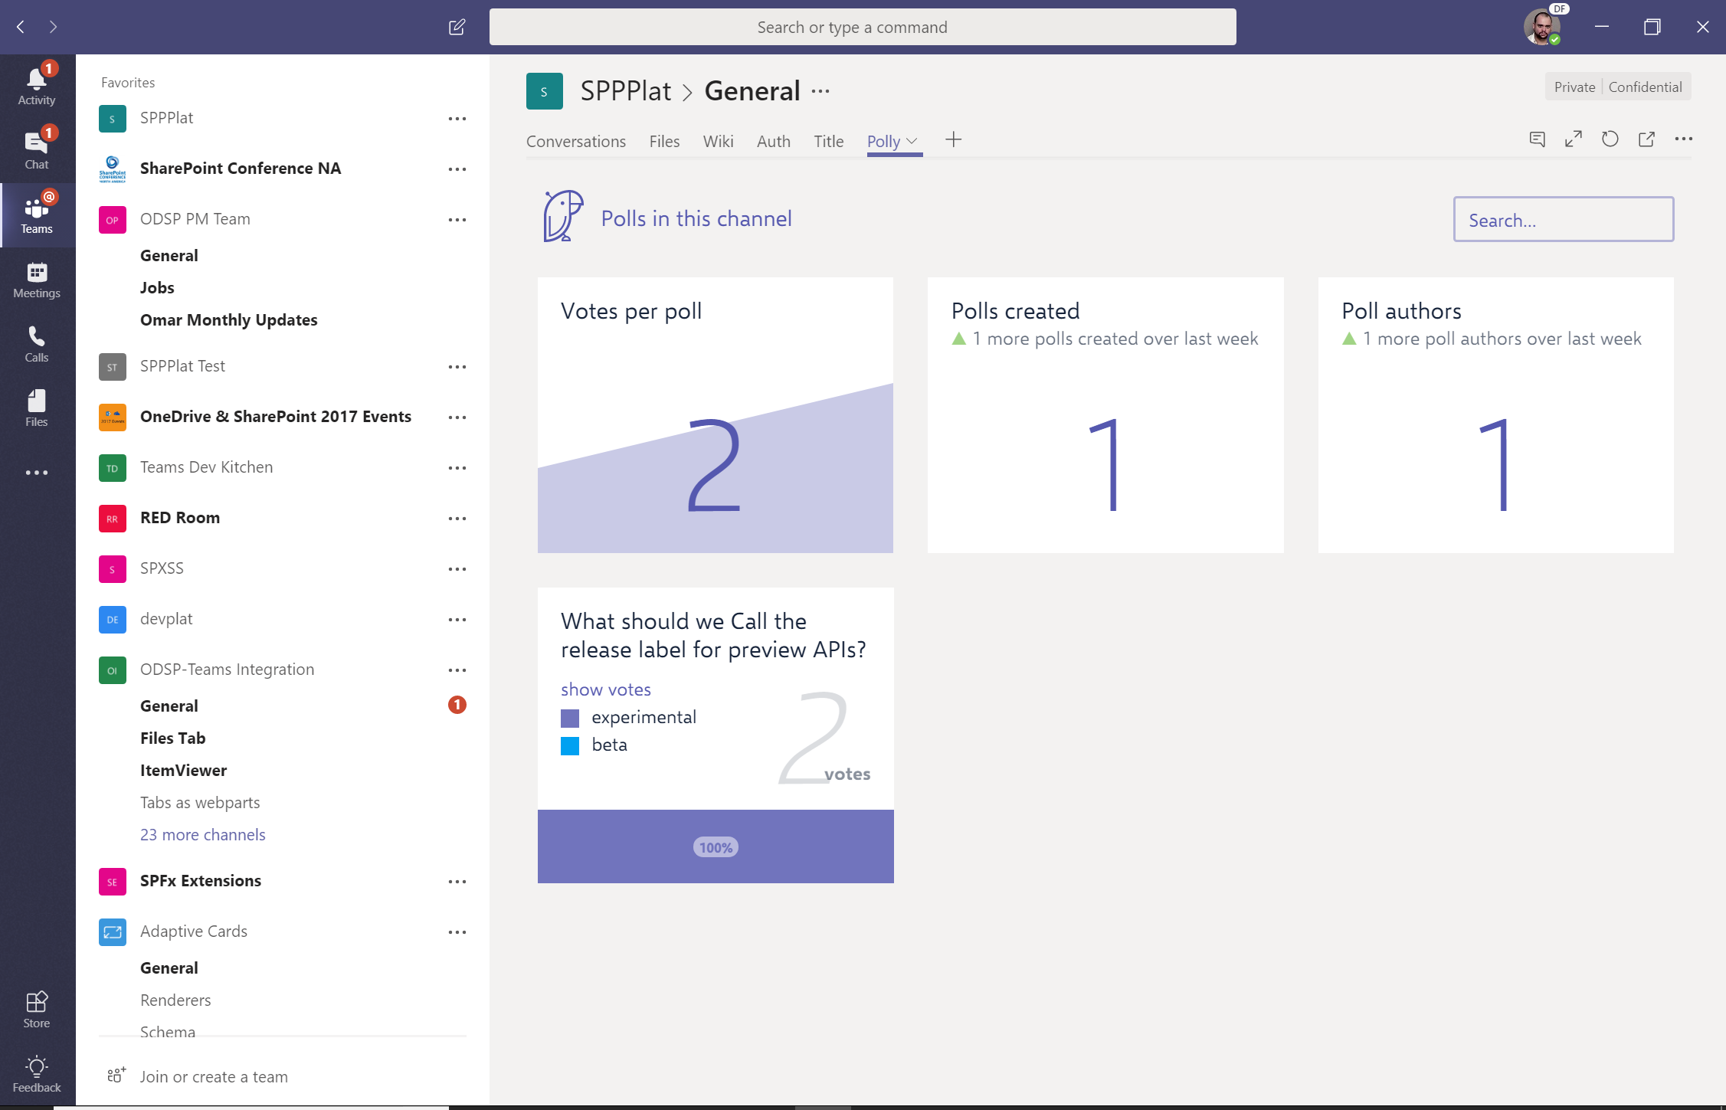
Teams SaaS/ISV Solutions in Teams
Coming later!

Slide 28
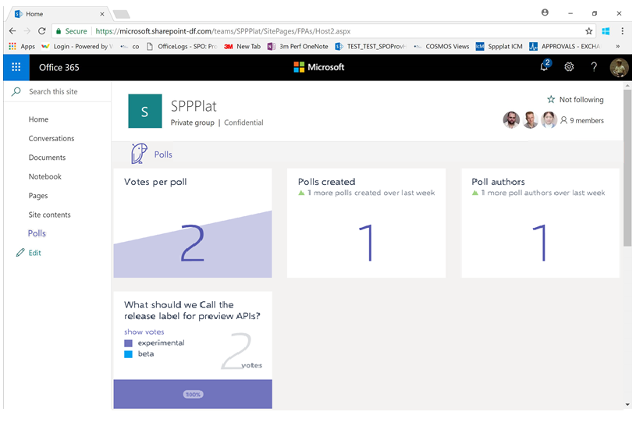
Teams SaaS/ISV Solutions in SharePoint
Coming later!

Slide 29
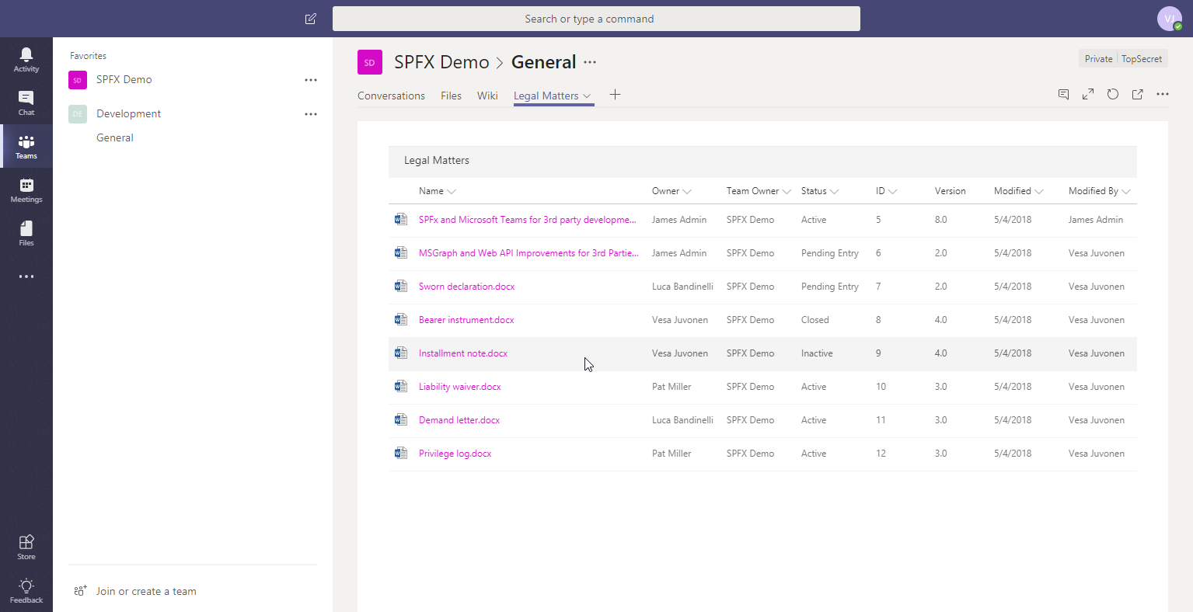
SharePoint as the hosting platform for your Microsoft Teams solutions
Preview soon!
Office 365 public CDN
js
JavaScript Library
SharePoint Online
SPFx Teams Application
All typical configuration available as for any SPFx solution – like asset packaging, CDN configuration, asset provisioning etc.
js
SPFx solution
Tenant App catalog
js
SPFx Teams solutions are deployed to Office 365 tenants using app catalog- Typical options for the sppkg file packaging and hosting available.
SPFx Teams application exposed in the Microsoft Teams as a tab (IFrame). Assets are hosted in SharePoint and published to Teams using standard Teams model.
JavaScript Library

Slide 30
DEMO
SharePoint and Teams – Unified development model for both services. Develop once, surface in both sides.

Slide 31
Open-source SharePoint Portal reference solution

Slide 32
Open-source SharePoint Portal reference solution
Coming soon!
Announcement
Open-source solution available in GitHub
>10 web parts, >5 extensions, >3 Site Designs with automatic tenant wide deployment
Initially with PowerShell, self-service site by Ignite
Demonstrates end-to-end solution design for modern SharePoint solution

Slide 33
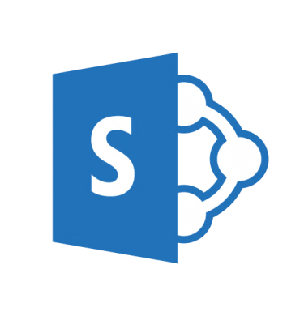

Road map - calendar year 2018
Spring
ALM APIs - General Availability
Asset packaging – General Availability
Tenant properties – General Availability
Site Collection App Catalog – General Availability
Native Graph access from SharePoint Framework - Preview
API and dev support for numerous out-of-the-box features
Summer / Fall
Native Graph access from SharePoint Framework GA
Enterprise solutions from SharePoint to Microsoft Teams
ISV solutions from Microsoft Teams to SharePoint
Global Deployment for SharePoint Framework
Dynamic data in SharePoint Framework components
SharePoint Framework at SharePoint 2019 – including modern experiences
More in details in SPC18 and Ignite

Slide 34
Learn
Reuse
Share
aka.ms/sppnp

Slide 35
Q&A
Q&A

Slide 36

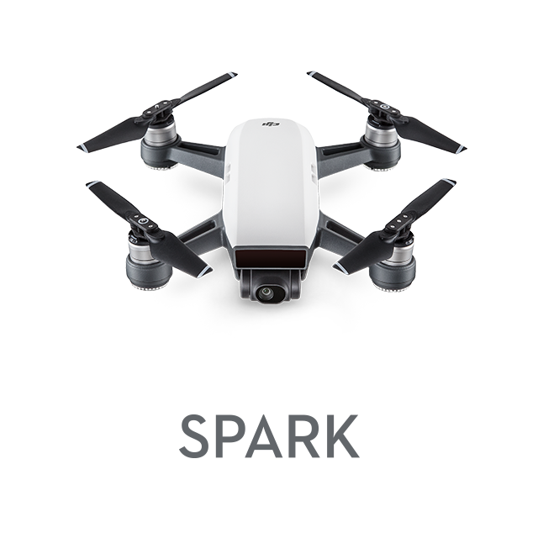

Daily Prizes
Xbox One X
DJI Spark Drone
Starbucks gift cards
Complete your evaluations to win prizes!
Be eligible to win! Make sure you are scanned into your session and complete your session eval to be eligible to win.
Seven winners each day! Winners will be notified via email.
Pick up your prize before leaving!
Prizes can be claimed at the info counter located on WSCC level 4, Galleria level.
Monday: pick up 2:15pm–6:30pm.
Tuesday: pick up 7:00am–6:00pm.
Wednesday: pick up 7:00am–5:30pm.
Please contact build@eventcore.com for more information

